Slide 1


Artificial Intelligence
Unit-2 (State Space Search)
Artificial Intelligence 3170716
Department of Computer Engineering
Unit#1 Introduction to Data Structures

Slide 2
Topics to be Covered
Defining The Problems As A State Space Search
Production Systems, Production Characteristics, Production System Characteristics and Issues in the Design of Search Programs

Slide 3
Problem solving
1.Problem solving is a process of generating solutions from observed data.
a ‘problem’ is characterized by a set of goals,
a set of objects, and
a set of operations.
These could be ill-defined and may evolve during problem solving.
2.A ‘problem space’ is an abstract space.
A problem space encompasses all valid states that can be generated by the application of any combination of operators on any combination of objects.
The problem space may contain one or more solutions. A solution is a combination of operations and objects that achieve the goals.
3.A ‘search’ refers to the search for a solution in a problem space.
Search proceeds with different types of ‘search control strategies’.
The depth-first search and breadth-first search are the two common search strategies.

Slide 4
Defining The Problems As A State Space Search
A State Space represents a problem in terms of states and operators that change states. A state space consists of:
A representation of the states the system can be in. For example, in a board game, the board represents the current state of the game.
A set of operators that can change one state into another state. In a board game, the operators are the legal moves from any given state. Often the operators are represented as programs that change a state representation to represent the new state.
An initial state.
A set of final states; some of these may be desirable, others undesirable. This set is often represented implicitly by a program that detects terminal states.

Slide 5
State Space Search: Water Jug Problem
“You are given two jugs, a 4-litre one and a 3-litre one.
Neither has any measuring markers on it. There is a
pump that can be used to fill the jugs with water. How
can you get exactly 2 litres of water into 4-litre jug.”

Slide 6
State Space Search: Water Jug Problem
State: (x, y)
x = 0, 1, 2, 3, or 4 y = 0, 1, 2, 3
x 🡪Quantity of water in 4 gallon jug
y🡪 Quantity of water in 3 gallon jug
Start state: (0, 0).
Goal state: (2, n) for any n.
Attempting to end up in a goal state.

Slide 7
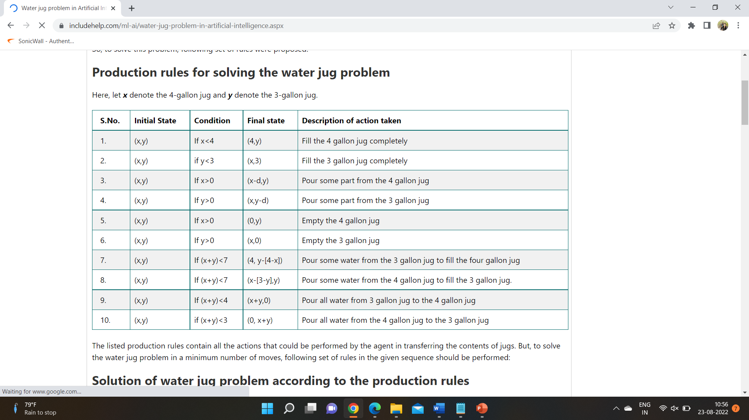
Production Rules for Water Jug Problem

Slide 8
Rules to define a Legal moves
1. (x, y) → (4, y)
if x < 4
2. (x, y) → (x, 3)
if y < 3
3. (x, y) → (x − d, y)
if x > 0
4. (x, y) → (x, y − d)
if y > 0

Slide 9
5. (x, y) → (0, y)
if x > 0
6. (x, y) → (x, 0)
if y > 0
7. (x, y) → (4, y − (4 − x))
if x + y ≥ 4, y > 0
8. (x, y) → (x − (3 − y), 3)
if x + y ≥ 3, x > 0

Slide 10
9. (x, y) → (x + y, 0)
if x + y ≤ 4, y > 0
10. (x, y) → (0, x + y)
if x + y ≤ 3, x > 0
11. (0, 2) → (2, 0)
12. (2, y) → (0, y)

Slide 11
One Solution
1. Current state = (0, 0)
2. Loop until reaching the goal state (2, 0)
− Apply a rule whose left side matches the current state
− Set the new current state to be the resulting state
(0, 0)
(0, 3) Rule-2
(3, 0) Rule-9
(3, 3) Rule-2
(4, 2) Rule-7
(0, 2) Rule-5 or Rule-12
(2, 0) Rule-9 or Rule-11

Slide 12
Special-purpose rules
Special-purpose rules to capture special-case
knowledge that can be used at some stage in solving a
Problem.
11. (0, 2) → (2, 0)
12. (2, y) → (0, y)

Slide 13
State Space Search: Summary
1. Define a state space that contains all the possible configurations of the relevant objects.
2. Specify the initial states.
3. Specify the goal states.
4. Specify a set of rules:
− What are unstated assumptions?
− How general should the rules be?
− How much knowledge for solutions should be in the
rules?

Slide 14
Production System
Production systems provide appropriate structures for performing and describing the search processes. A production system has four basic components as enumerated below.
A set of rules each consisting of a left side that determines the applicability of the rule and a right side that describes the operation to be performed if the rule is applied.
A Database or Knowledge Base of current facts established during the process of inference.
A Control Strategy that specifies the order in which the rules will be compared with facts in the database and also specifies how to resolve conflicts in selection of several rules or selection of more facts.
A Rule firing module

Slide 15
Characteristics of Production Systems
A Monotonic Production System is a production system in which the application of a rule never prevents the later application of another rule that could also have been applied at the time the first rule was selected.
A Non-Monotonic Production System is one in which this is not true.
A Partially Communicative Production System is a production system with the property that if the application of a particular sequence of rules transforms state P into state Q, then any combination of those rules that is allowable also transforms state P into state Q.
A Commutative Production System is a production system that is both monotonic and partially commutative.

Slide 16
Features of Production System
1. Simplicity
• The structure of each sentence in a production system is unique and uniform as they use “IF-THEN” structure.
• This structure provides simplicity in knowledge representation.
2. Modularity
• This means production rule code the knowledge available in discrete pieces. Information can be treated as a collection of independent facts which may be added or deleted from the system with essentially no delete side effects.
3. Modifiability
• This means the facility of modifying rules.
• It allows the development of production rules in a skeletal form first and then it is accurate to suit a specific application.
4. Knowledge intensive
• knowledge base of production system stores pure knowledge.
• Each production rule is normally written as an English sentence; the problem of semantics is solved by the very structure of the representation.

Slide 17
Advantages of Production System
Provides excellent tools for structuring AI programs .
The system is highly modular because individual rules can be added, removed or modified independently.
Separation of knowledge and Control-Recognises Act Cycle
A natural mapping onto state-space research data or goal-driven.
The system uses pattern directed control which is more flexible than algorithmic control.
Provides opportunities for heuristic control of the search.
A good way to model the state-driven nature of intelligent machines.
Quite helpful in a real-time environment and applications.

Slide 18
Disadvantages of Production System
It is very difficult to analyze the flow of control within a production system.
It describes the operations that can be performed in a search for a solution to the problem.
There is an absence of learning due to a rule-based production system that does not store the result of the problem for future use.
The rules in the production system should not have any type of conflict resolution as when a new rule is added to the database it should ensure that it does not have any conflict with any existing rule.

Slide 19
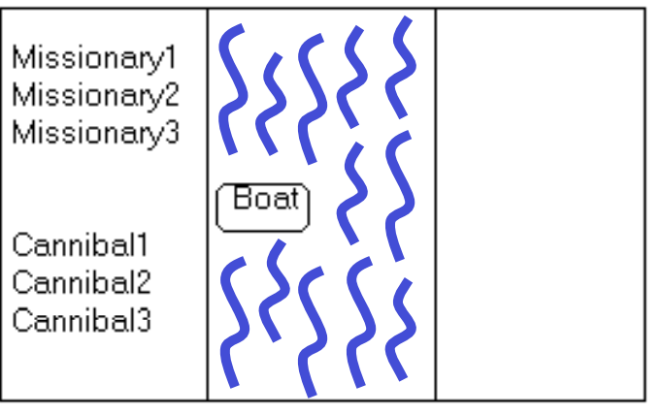
Missionaries and Cannibals Problem
Three missionaries and three cannibals wish to cross the river. They have a small boat that will carry up to two people. Everyone can navigate the boat. If at any time the Cannibals outnumber the Missionaries on either bank of the river, they will eat the Missionaries. Find the smallest number of crossings that will allow everyone to cross the river safely.

Slide 20
Missionaries and Cannibals
Goal: Move all the missionaries and cannibals across the river.
Constraint: Missionaries can never be outnumbered by cannibals on either side of river, or else the missionaries are killed.
State: configuration of missionaries and cannibals and boat on each side of river.
Initial State: 3 missionaries, 3 cannibals and the boat are on the near bank
Operators: Move boat containing some set of occupants across the river (in either direction) to the other side.

Slide 21
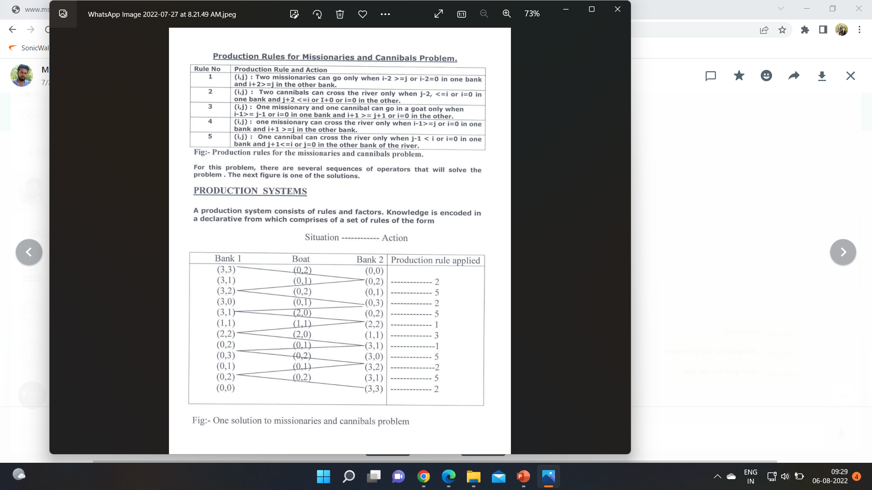
Missionaries and Cannibals

Slide 22
Missionaries and Cannibals

Slide 23
Search Strategies/Control Strategies
The word ‘search’ refers to the search for a solution in a problem space.
Properties of Search Algorithms
Completeness: A search algorithm is complete when it returns a solution for any input if at least one solution exists for that particular input.
Optimality: If the solution deduced by the algorithm is the best solution, i.e. it has the lowest path cost, then that solution is considered as the optimal solution.
Time and Space Complexity: Time complexity is the time taken by an algorithm to complete its task, and space complexity is the maximum storage space needed during the search operation.

Slide 24
Types of Search strategies
1. Uninformed search (blind search)
Having no information about the number of steps from the current state to the goal.
2. Informed search (heuristic search)
More efficient than uninformed search.

Slide 25
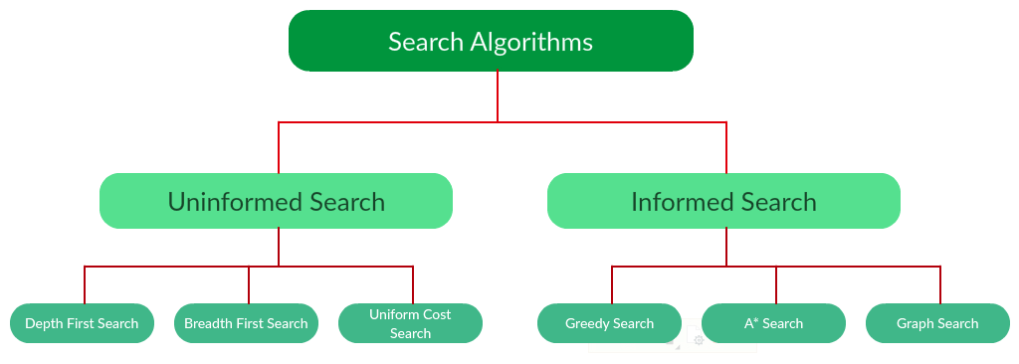

Slide 26
Difference Between Search Algorithms
Criteria | Uninformed Search | Informed Search
Utilizing Knowledge | It does not require using any knowledge during the process of searching. | It uses knowledge during the process of searching.
Speed | Finding the solution is much slower comparatively. | Finding the solution is quicker.
Completion | It is always bound to give optimal solution. | It may or may not give optimal solution.
Consumption of Time | Due to slow searches, it consumes comparatively more time. | Due to a quicker search, it consumes much less time.
Cost Incurred | The expenses are comparatively higher. | The expenses are much lower.
Suggestion/ Direction | The AI does not get any suggestions regarding what solution to find and where to find it. Whatever knowledge it gets is out of the information provided. | The AI gets suggestions regarding how and where to find a solution to any problem.
Efficiency | It costs more and generates slower results. Thus, it is comparatively less efficient. | It costs less and generates quicker results. Thus, it is comparatively more efficient.
Examples | Breadth-First Search or BFS and Depth-First Search or DFS. | Graph Search ,Greedy Search , A*,AO*

Slide 27
Uninformed Search
The search algorithms in this section have no additional information on the goal node other than the one provided in the problem definition.
The plans to reach the goal state from the start state differ only by the order and/or length of actions. Uninformed search is also called Blind search.
1. Depth First Search
2. Breath First Search
3. Uniform Cost Search

Slide 28
Uninformed Search
Each of these algorithms will have:
1. A problem graph, containing the start node S and the goal node G.
2. A strategy, describing the manner in which the graph will be
traversed to get to G .
3. A fringe, which is a data structure used to store all the possible states (nodes) that you can go from the current states.
4. A tree, that results while traversing to the goal node.
5. A solution plan, which the sequence of nodes from S to G.

Slide 29
Queue for Frontier
FIFO (First In, First Out)
Results in Breadth-First Search
LIFO (Last In, First Out)
Results in Depth-First Search
Priority Queue sorted by path cost so far
Results in Uniform Cost Search
Iterative Deepening Search uses Depth-First
Bidirectional Search can use either Breadth-First or Uniform Cost Search

Slide 30
BFS-Breadth First Search
Breadth-first search (BFS) is an algorithm for traversing or searching tree or graph data structures.
It starts at the tree root, and explores all of the neighbor nodes at the present depth prior to moving on to the nodes at the next depth level.

Slide 31
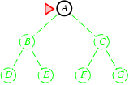
Breadth-first search
Expand shallowest unexpanded node
Frontier (or fringe): nodes in queue to be explored
Frontier is a first-in-first-out (FIFO) queue, i.e., new successors go at end of the queue.
Goal-Test when inserted.
Future= green dotted circles
Frontier=white nodes
Expanded/active=gray nodes
Forgotten/reclaimed= black nodes
Initial state = A
Is A a goal state?
Put A at end of queue.
frontier = [A]

Slide 32
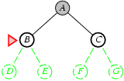
Breadth-first search
Expand shallowest unexpanded node
Frontier is a FIFO queue, i.e., new successors go at end
Expand A to B, C.
Is B or C a goal state?
Put B, C at end of queue.
frontier = [B,C]

Slide 33
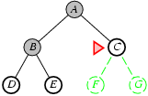
Breadth-first search
Expand shallowest unexpanded node
Frontier is a FIFO queue, i.e., new successors go at end
Expand B to D, E
Is D or E a goal state?
Put D, E at end of queue
frontier=[C,D,E]

Slide 34
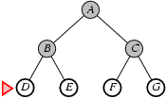
Breadth-first search
Expand shallowest unexpanded node
Frontier is a FIFO queue, i.e., new successors go at end
Expand C to F, G.
Is F or G a goal state?
Put F, G at end of queue.
frontier = [D,E,F,G]

Slide 35
Breadth-first search
Expand shallowest unexpanded node
Frontier is a FIFO queue, i.e., new successors go at end
Expand D to no children.
Forget D.
frontier = [E,F,G]

Slide 36
Breadth-first search
Expand shallowest unexpanded node
Frontier is a FIFO queue, i.e., new successors go at end
Expand E to no children.
Forget B,E.
frontier = [F,G]

Slide 37
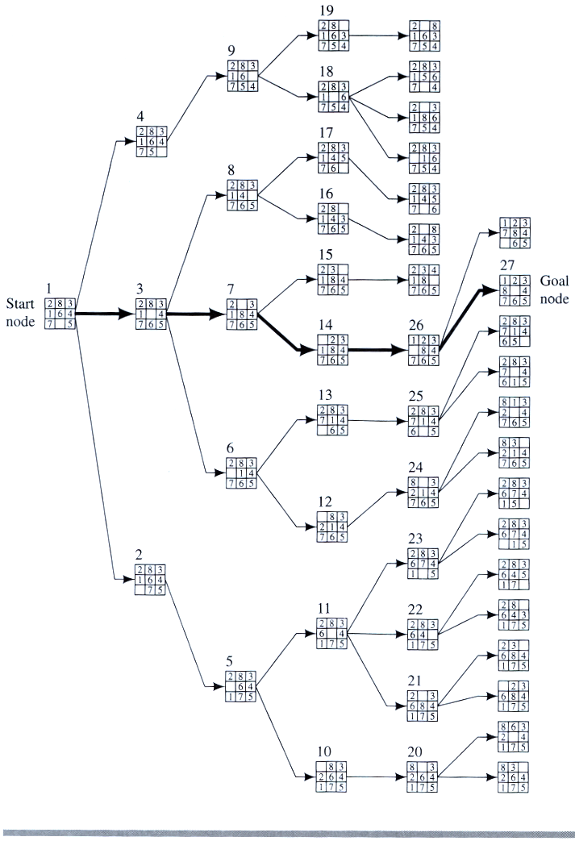
Example
BFS
8 PUZZLE PROBLEM

Slide 38
Properties of breadth-first search
Complete? Yes, it always reaches a goal (if b is finite)
Time? 1+b+b²+b³+… + b^{d} = O(b^{d})
(this is the number of nodes we generate)
Space? O(b^{d}) (keeps every node in memory,
either in fringe or on a path to fringe).
Optimal? No, for general cost functions.
Yes, if cost is a non-decreasing function only of depth.
With f(d) ≥ f(d-1), e.g., step-cost = constant:
All optimal goal nodes occur on the same level
Optimal goal nodes are always shallower than non-optimal goals
An optimal goal will be found before any non-optimal goal
Space is the bigger problem (more than time)

Slide 39
DFS-Depth First Search
Depth-first search (DFS) is an algorithm for traversing or searching tree or graph data structures.
The algorithm starts at the root node and explores as far as possible along each branch before backtracking.

Slide 40
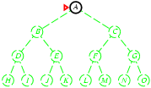
Depth-first search
Expand deepest unexpanded node
Frontier = Last In First Out (LIFO) queue, i.e., new successors go at the front of the queue.
Goal-Test when inserted.
Future= green dotted circles
Frontier=white nodes
Expanded/active=gray nodes
Forgotten/reclaimed= black nodes
Initial state = A
Is A a goal state?
Put A at front of queue.
frontier = [A]

Slide 41
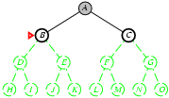
Depth-first search
Expand deepest unexpanded node
Frontier = LIFO queue, i.e., put successors at front
Expand A to B, C.
Is B or C a goal state?
Put B, C at front of queue.
frontier = [B,C]
Future= green dotted circles
Frontier=white nodes
Expanded/active=gray nodes
Forgotten/reclaimed= black nodes

Slide 42
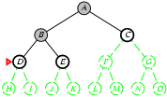
Depth-first search
Expand deepest unexpanded node
Frontier = LIFO queue, i.e., put successors at front
Expand B to D, E.
Is D or E a goal state?
Put D, E at front of queue.
frontier = [D,E,C]
Future= green dotted circles
Frontier=white nodes
Expanded/active=gray nodes
Forgotten/reclaimed= black nodes

Slide 43
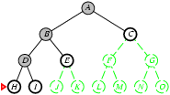
Depth-first search
Expand deepest unexpanded node
Frontier = LIFO queue, i.e., put successors at front
Expand D to H, I.
Is H or I a goal state?
Put H, I at front of queue.
frontier = [H,I,E,C]
Future= green dotted circles
Frontier=white nodes
Expanded/active=gray nodes
Forgotten/reclaimed= black nodes

Slide 44
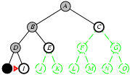
Depth-first search
Expand deepest unexpanded node
Frontier = LIFO queue, i.e., put successors at front
Expand H to no children.
Forget H.
frontier = [I,E,C]
Future= green dotted circles
Frontier=white nodes
Expanded/active=gray nodes
Forgotten/reclaimed= black nodes

Slide 45
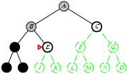
Depth-first search
Expand deepest unexpanded node
Frontier = LIFO queue, i.e., put successors at front
Expand I to no children.
Forget D, I.
frontier = [E,C]
Future= green dotted circles
Frontier=white nodes
Expanded/active=gray nodes
Forgotten/reclaimed= black nodes

Slide 46
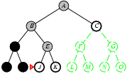
Depth-first search
Expand deepest unexpanded node
Frontier = LIFO queue, i.e., put successors at front
Expand E to J, K.
Is J or K a goal state?
Put J, K at front of queue.
frontier = [J,K,C]
Future= green dotted circles
Frontier=white nodes
Expanded/active=gray nodes
Forgotten/reclaimed= black nodes

Slide 47
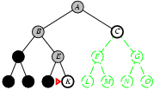
Depth-first search
Expand deepest unexpanded node
Frontier = LIFO queue, i.e., put successors at front
Expand I to no children.
Forget D, I.
frontier = [E,C]
Future= green dotted circles
Frontier=white nodes
Expanded/active=gray nodes
Forgotten/reclaimed= black nodes

Slide 48
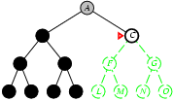
Depth-first search
Expand deepest unexpanded node
Frontier = LIFO queue, i.e., put successors at front
Expand K to no children.
Forget B, E, K.
frontier = [C]
Future= green dotted circles
Frontier=white nodes
Expanded/active=gray nodes
Forgotten/reclaimed= black nodes

Slide 49
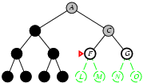
Depth-first search
Expand deepest unexpanded node
Frontier = LIFO queue, i.e., put successors at front
Future= green dotted circles
Frontier=white nodes
Expanded/active=gray nodes
Forgotten/reclaimed= black nodes
Expand C to F, G.
Is F or G a goal state?
Put F, G at front of queue.
frontier = [F,G]

Slide 50
Properties of depth-first search
Complete? No: fails in loops/infinite-depth spaces
Can modify to avoid loops/repeated states along path
check if current nodes occurred before on path to root
Can use graph search (remember all nodes ever seen)
problem with graph search: space is exponential, not linear
Still fails in infinite-depth spaces (may miss goal entirely)
Time? O(b^{m}) with m =maximum depth of space
Terrible if m is much larger than d
If solutions are dense, may be much faster than BFS
Space? O(bm), i.e., linear space!
Remember a single path + expanded unexplored nodes
Optimal? No: It may find a non-optimal goal first
A
B
C

Slide 51
Uniform-cost search
Breadth-first is only optimal if path cost is a non-decreasing function of depth, i.e., f(d) ≥ f(d-1); e.g., constant step cost, as in the 8-puzzle.
Can we guarantee optimality for variable positive step costs ≥ε?
(Why ≥ε? To avoid infinite paths w/ step costs 1, ½, ¼, …)
Uniform-cost Search:
Expand node with smallest path cost g(n).
Frontier is a priority queue, i.e., new successors are merged into the queue sorted by g(n).
Can remove successors already on queue w/higher g(n).
Saves memory, costs time; another space-time trade-off.
Goal-Test when node is popped off queue.

Slide 52
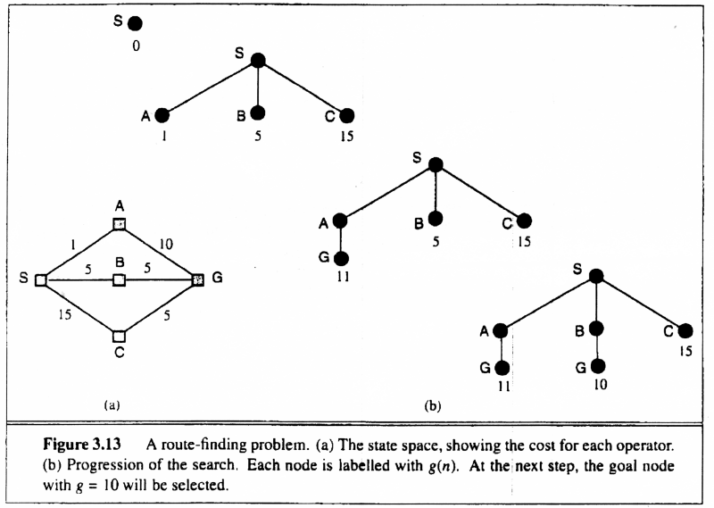
Uniform-cost search
Uniform-cost Search:
Expand node with smallest path cost g(n).
Proof of Completeness:
Given that every step will cost more than 0,
and assuming a finite branching factor, there
is a finite number of expansions required before
the total path cost is equal to the path cost of the
goal state. Hence, we will reach it.
Proof of optimality given completeness:
Assume UCS is not optimal.
Then there must be an (optimal) goal state with
path cost smaller than the found (suboptimal) goal
state (invoking completeness).
However, this is impossible because UCS would
have expanded that node first by definition.
Contradiction.

Slide 53
A
6
D
1
F
3
1
S
2
4
8
G
B
E
1
20
C
The graph above shows the step-costs for different paths going from the start (S) to
the goal (G).
Use uniform cost search to find the optimal path to the goal.
Exercise for at home

Slide 54
References
(Chapter 3 – AI Rich & Knight)

